Slide 1
Capstone Project
Is there a relationship between salary level and job satisfaction, or do other factors matter more?
Caroline Cherekos & Anna Rafferty
SDT 100 - Intro to Data Analytics
1

Slide 2
Table of contents
01
02
03
04
05
Business Context
Data Overview + Visualization
Statistical Results
Business Implications
Recommendations
2

Slide 3

01
Business Context
The Problem
Higher annual salary ≠ higher satisfaction
Existing research: yearly salary has little effect
Why Job Satisfaction Levels Matter
Employees: quality of work, lower risk of burnout, etc.
Employers: lower turnover rate, higher performance, etc.
Our Analysis
Correlation between annual salary and job satisfaction levels
Software developers in U.S.
Sole factor or multi-faceted?
3

Slide 4
02
Data Overview
Data Source
The Stack Overflow Annual Developer Survey, 2025
49,000 responses from 177+ countries
Data Filtering & Cleaning
Python/Google Colab
Filtered: U.S. residents, full-time employees, 1-30 years of experience, salaries between $30,000-$500,000
Incomplete data removed → 4,000 usable responses
Selected columns: Job Satisfaction, Converted Comp Yearly, and Work Experience
Key Variables
Independent variable: Salary level
Dependent variable: Job satisfaction
4

Slide 5
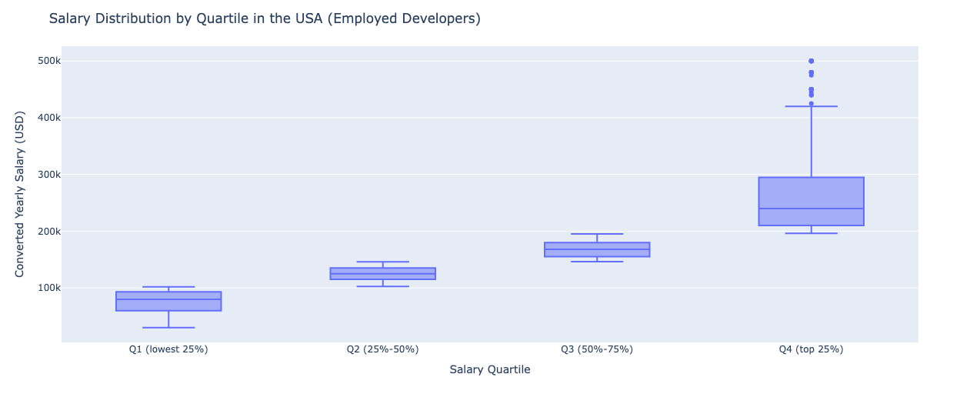
Data Visualization 1
Salary Distribution by Quartile in the U.S.
5

Slide 6
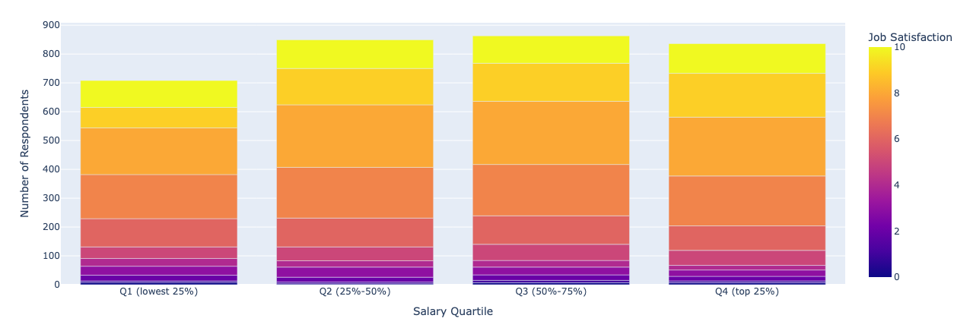
Data Visualization 2
Job Satisfaction Levels by Salary Quartile
6

Slide 7
03
Statistical Results
Key Findings
Salary Quartiles (Q1–Q4) show increasing median salary but similar job satisfaction spread across all groups
Mean ‘JobSat’ increases only 0.37 points from Q1 to Q4 (7.02 → 7.39)
Standard deviations and ranges nearly identical across quartiles: high spread in all groups
Extremely weak, positive, no linear relationship
Interpretation
Salary affects satisfaction only marginally
High and low earners report both high and low satisfaction levels
Findings support diminishing returns: increasing salary provides minimal gains in job satisfaction
7

Slide 8
04
Business Implications
Money vs. Meaningful Work
Compensation matters, but results show it is not the primary driver of job satisfaction
Employees value:
Positive workplace culture
Work life balance
Wellness and stability
Opportunity for growth and recognition
Retention Strategies Beyond Pay
Culture: Trust, collaboration, psychological safety
Flexibility: Remote/hybrid options, flexible scheduling
Career Development: Skill-building, clear promotion paths
Recognition: Non-monetary rewards, regular feedback
Diminishing Returns on Salary
Companies over-relying on pay increases will see little improvement in morale
8

Slide 9
05
Recommendations
Build a Holistic Benefits Package
Prioritize employee-valued perks: health/wellness, PTO, paternity leave, retirement support
Communicate to see which benefits are necessary and what employees prefer
Strengthen Work Life Balance
Implement hybrid or flexible scheduling
Reduce burnout by supporting reasonable hours and personal time management
Invest in Culture
Foster supportive leadership and team reliability
Encourage collaboration, respect, and safety
Provide Growth & Recognition
Offer skill development and transparent promotion pathways
Recognize/reward contributions consistently
9

Slide 10
Questions?
10

Slide 11
Resources
Bolden-Barrett, V. (2019, April 4). Study: Most workers are fairly happy on the job, but low pay remains a sticking point. HR Dive. https://www.hrdive.com/news/study-most-workers-ar
e-fairly-happy-on-the-job-but-low-pay-remains-a-stic/551906/
Montuori, P., Sorrentino, M., Sarnacchiaro, P., Di Duca, F., Nardo, A., Ferrante, B., D’Angelo, D., Di Sarno, S., Pennino, F., Masucci, A., Triassi, M., & Nardone, A. (2022). Job Satisfaction: Knowledge, Attitudes, and Practices Analysis in a Well-Educated Population. International Journal of Environmental Research and Public Health, 19(21), 1–12. https://doi.org/10.3390/ijerph192114214
Shashenkova, L. (2024, February 8). What is Job Satisfaction and How Does It Affect Performance? Bain and Gray. https://www.bainandgray.com/blog/what-is-job-satisfaction
-and-how-does-it-effect-performance
Stack Overflow Insights - Developer Hiring, Marketing, and User Research. (n.d.).
survey.stackoverflow.co. https://survey.stackoverflow.co/
Walker, Elizabeth. “Job Satisfaction Factors: Identifying the Right Benefits.” Job Satisfaction Factors: Identifying the Right Benefits, PeopleKeep, Inc., 11 Oct. 2024, www.peoplekeep.com/blog/factors-influencing-job-satisfaction.
11

